Slide 1

Bird Songs
Photographs and audio courtesy of ebird.org

Slide 2

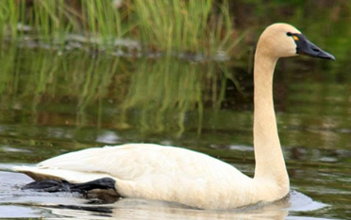
Tundra Swan

Slide 3
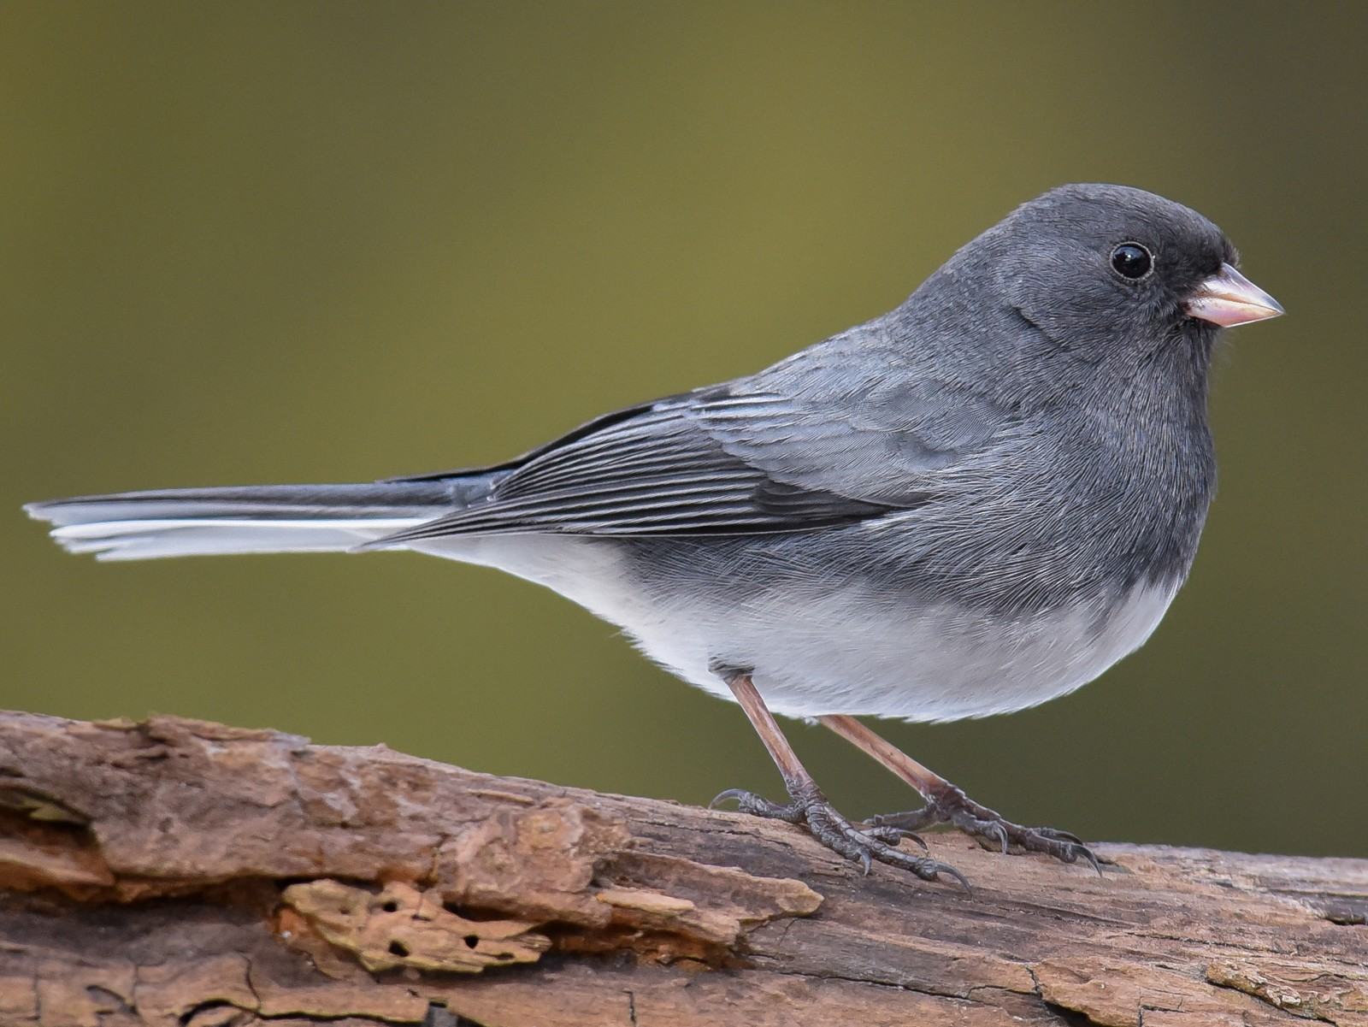
Dark-eyed Junco

Slide 4
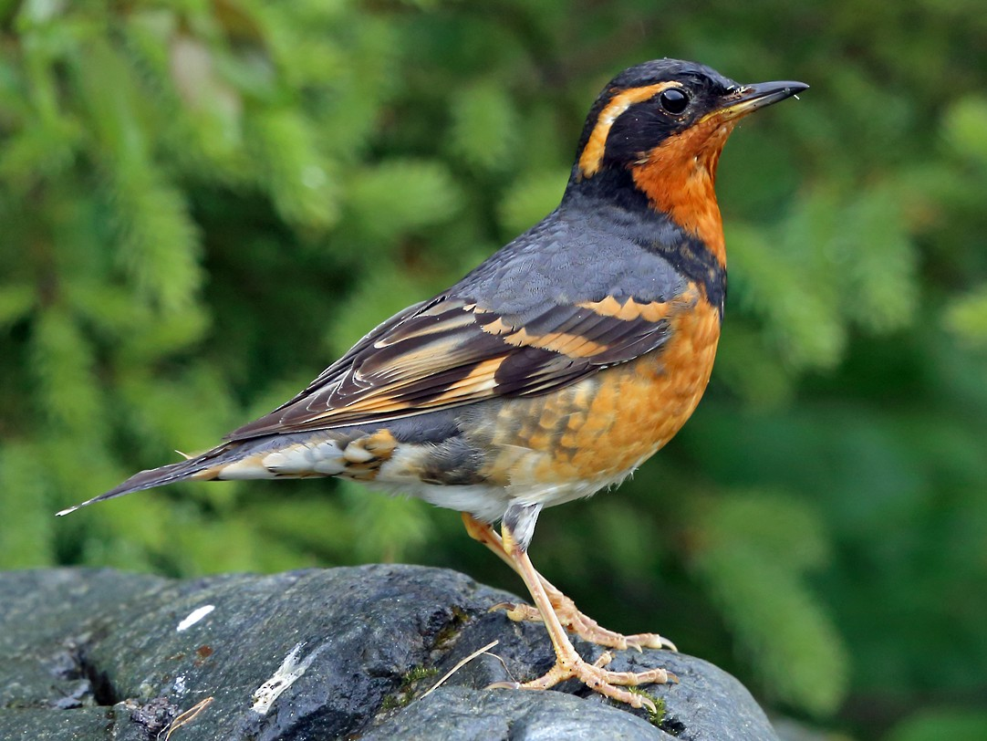
Varied Thrush

Slide 5
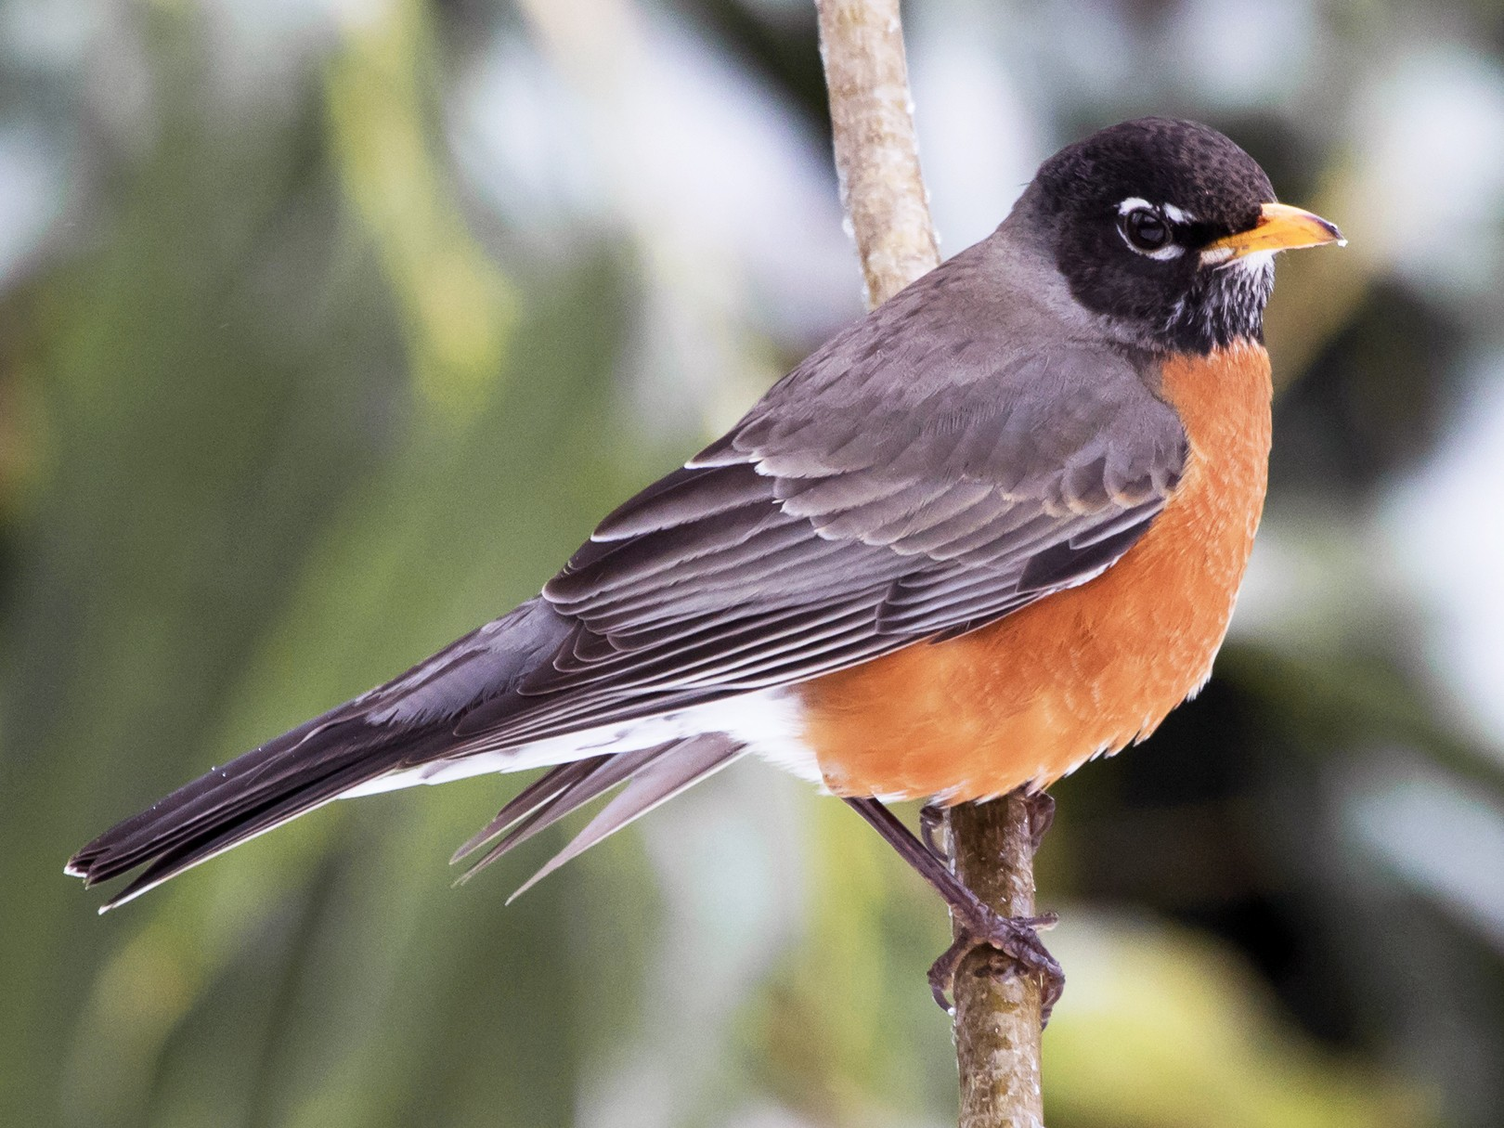
American Robin

Slide 6
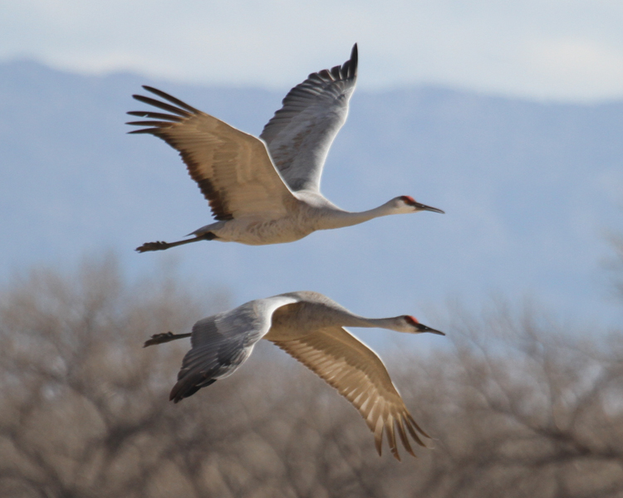
Sandhill Crane

Slide 7
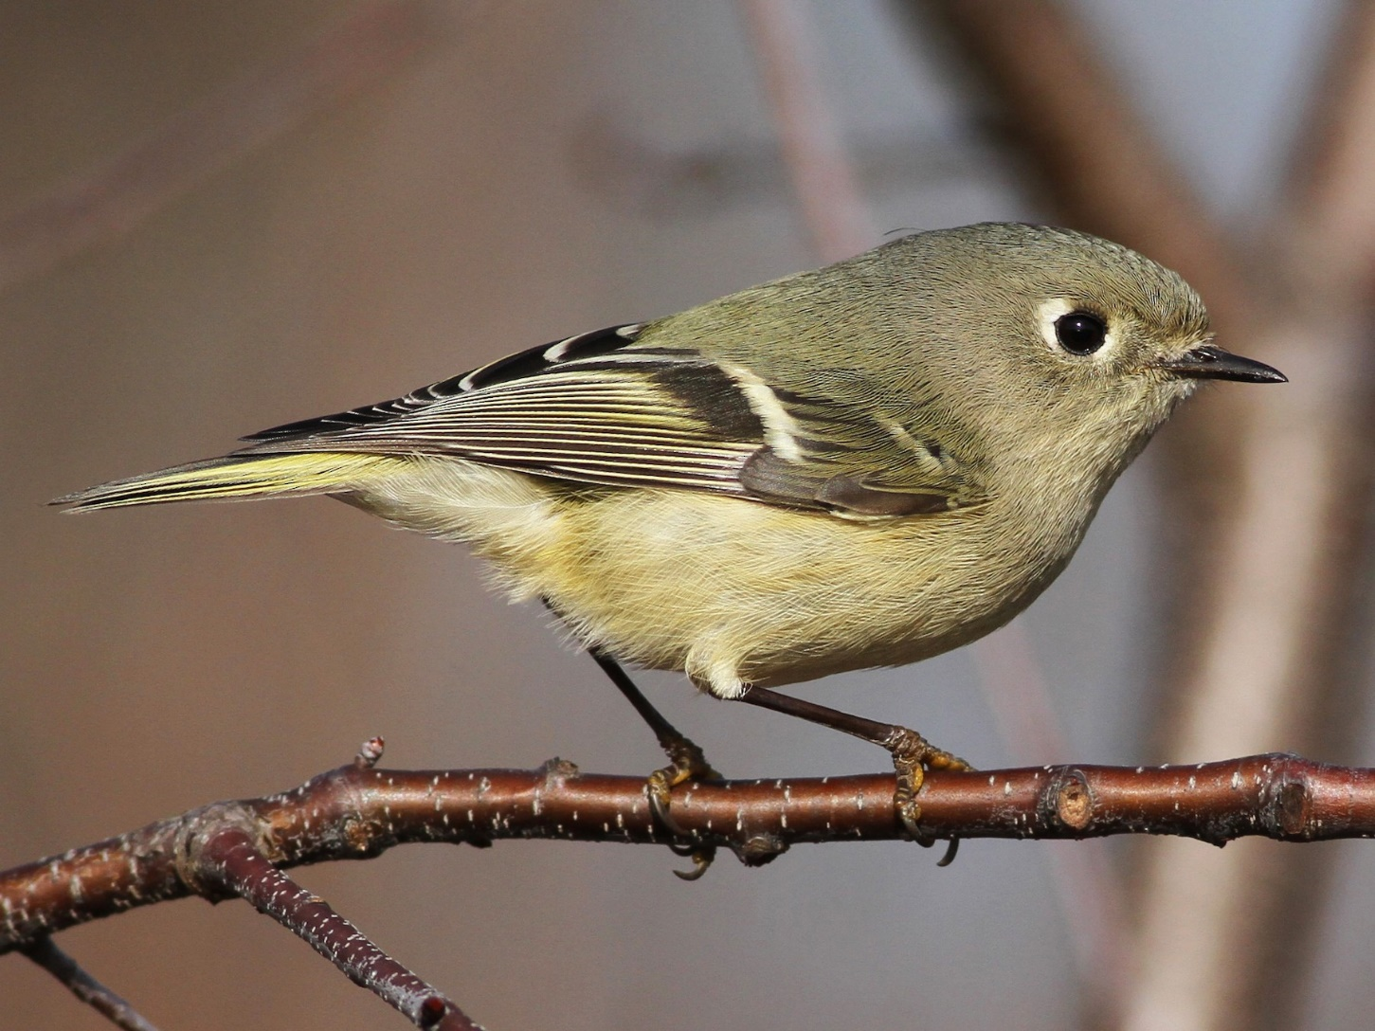
Ruby-crowned Kinglet

Slide 8
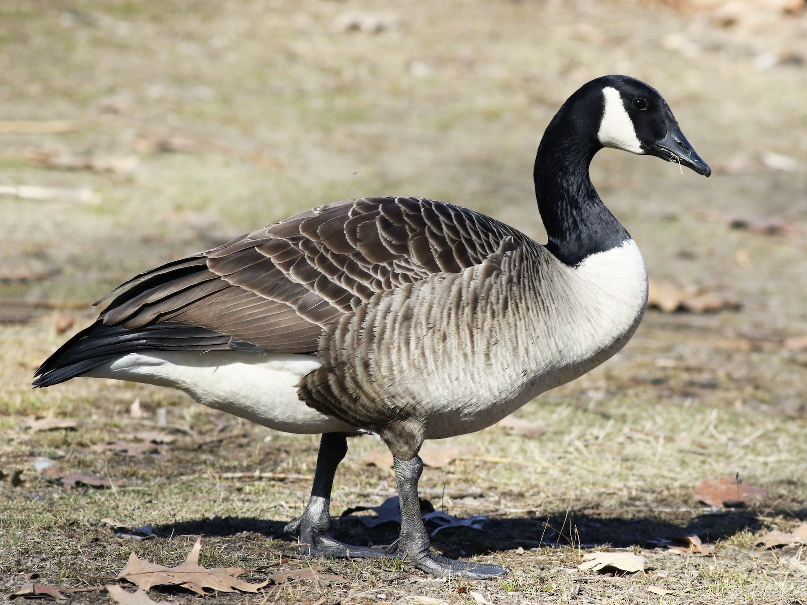
Canada Goose

Slide 9
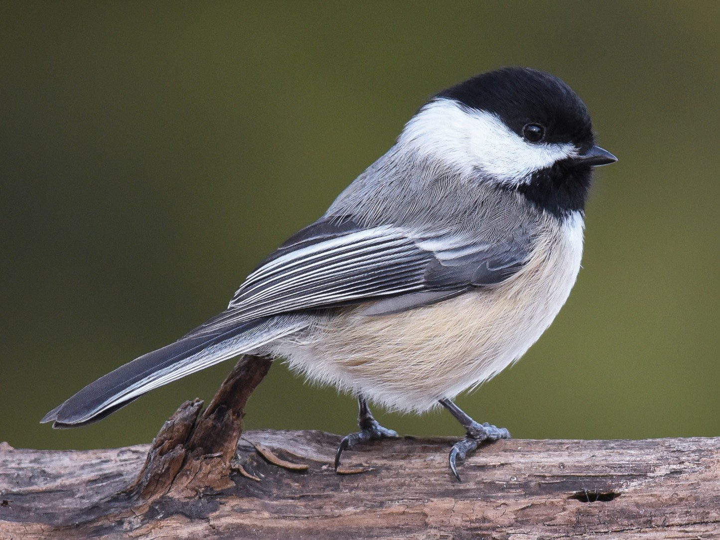
Black-capped Chickadee

Slide 10
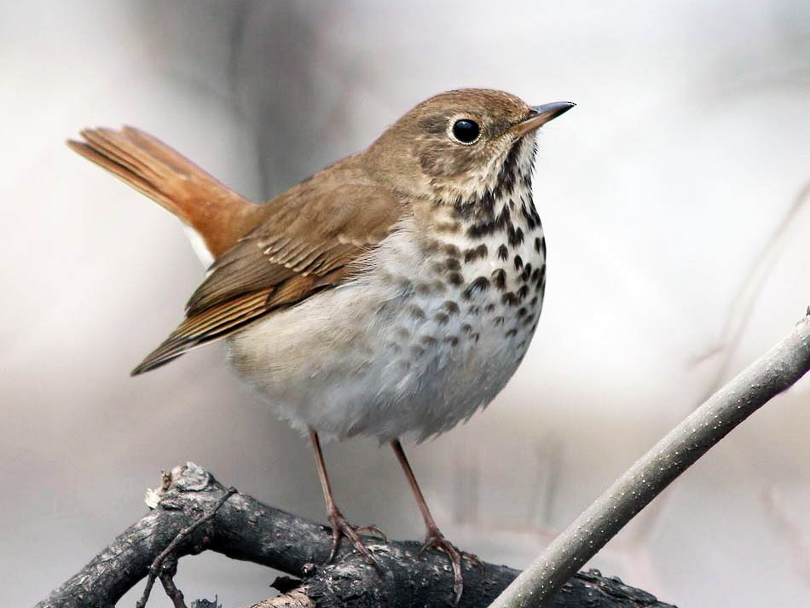
Hermit Thrush

Slide 11
Quiz Time!
Draw a line connecting the bird picture with its appropriate call.

Slide 12
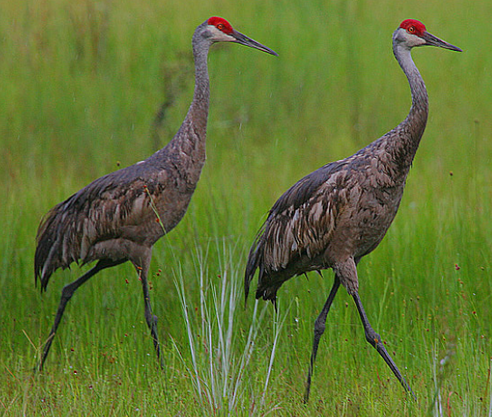
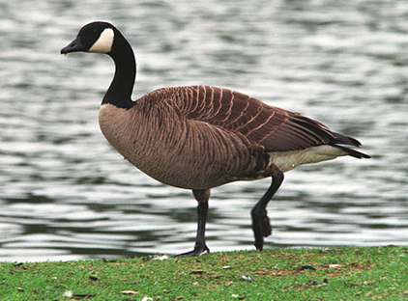
Quiz 1
Song 1
Song 2
Song 3

Slide 13
Sandhill Crane
Tundra Swan
Canada Goose

Slide 14
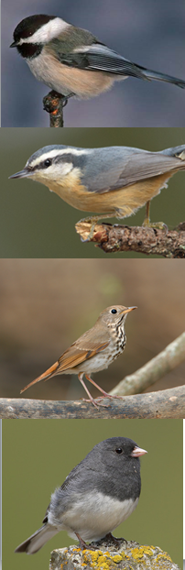
Quiz 2
Song 4
Song 5
Song 6

Slide 15
Quiz 2
Dark-eyed Junco
Black-capped Chickadee
Hermit Thrush

Slide 16
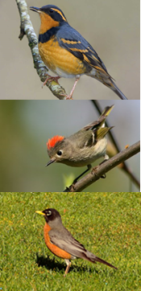
Quiz 3
Song 7
Song 8
Song 9

Slide 17
Quiz 3
Ruby-crowned kinglet
American Robin
Varied Thrush

