Slide 1
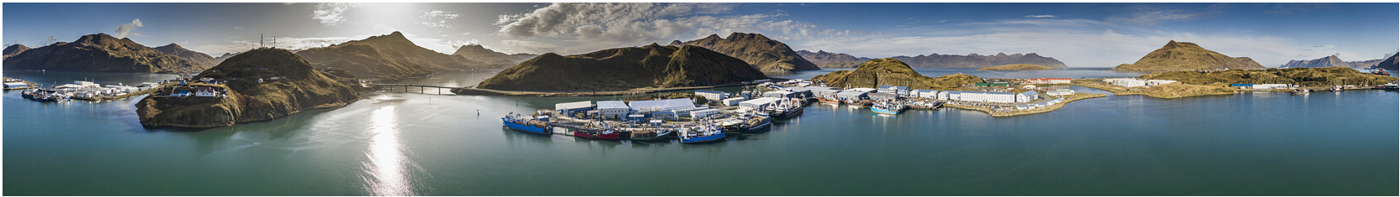

North Pacific Fishery Management Council Overview
Dutch Harbor, ASMI Industry and Partner Use
Diana L. Stram, PhD
Senior Scientist
North Pacific Fishery Management Council
Anchorage, AK
diana.stram@noaa.gov

Slide 2
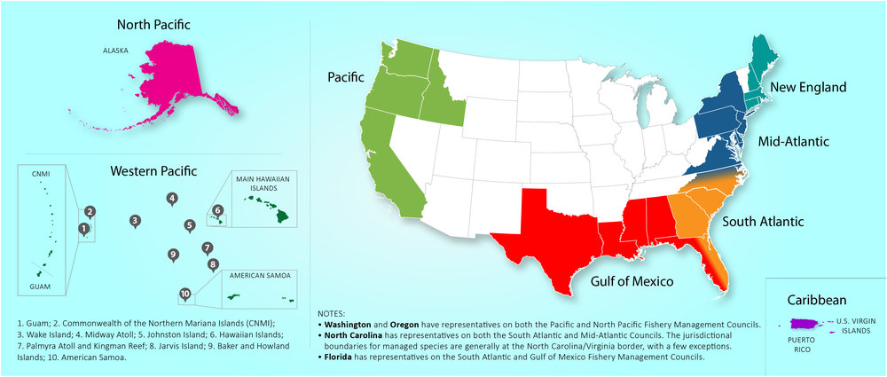

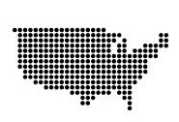

The Guiding Law for U.S. Marine Fisheries
The Magnuson-Stevens Fishery Conservation and Management Act – Adopted 1976
200-mile limit
National Standards
8 Councils
Established the 3-200 nautical mile exclusive economic zone
Established National Standards and other requirements for conservation and management of resources
Established a system of 8 Regional Councils, composed of fishermen and government representatives, to develop fishery regulations for their specific area
Notes:
Magnuson-Stevens Fishery Conservation and Management Act is the primary law guiding Fisheries management in Federal waters.
Federal waters are in the Nation’s Exclusive Economic Zone 3 to 200 nautical miles from shore.
Magnuson Stevens Act also created 10 National Standards which are requirements conservation and management of resources.
established the eight regional fishery management councils. The regions represented by those councils are on the right. The North Pacific Council has jurisdiction over Federal waters off Alaska’s coast.
Notes
Yes, the Council and NMFS are required to consider and balance all National Standards. There is inherently some tension in trying to balancing all ten but they all must be considered. Some are mandatory (e.g., national standard 2) while others require consideration to the extent practicable (e.g., NS 9). NS1 also provides clear direction that any management measures implemented under the MSA must (1) prevent overfishing and (2) achieve, on a continuing basis, the optimum yield from each fishery.

Slide 3
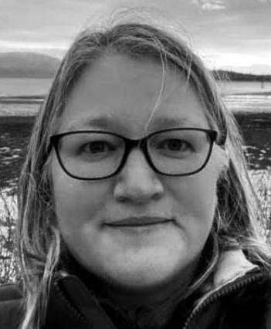
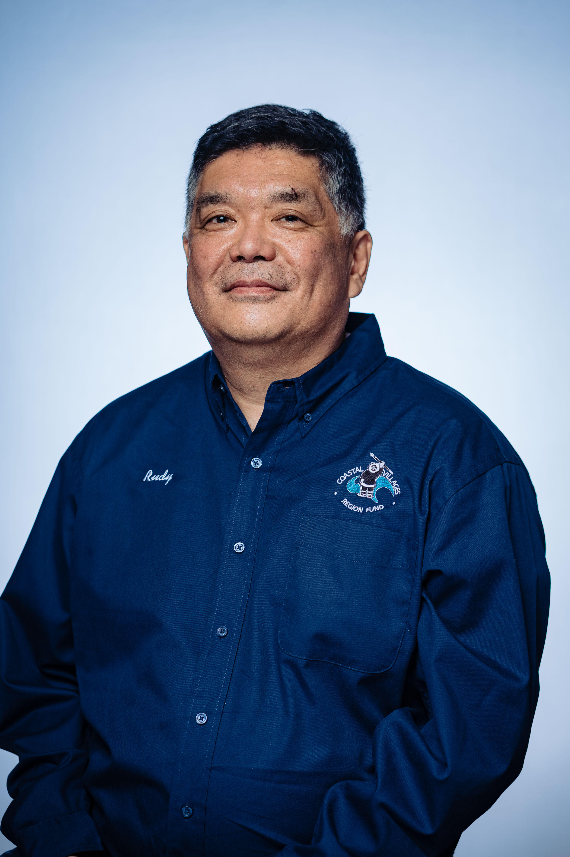


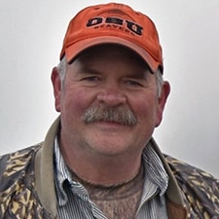




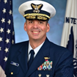

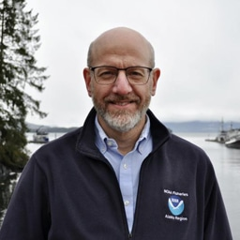
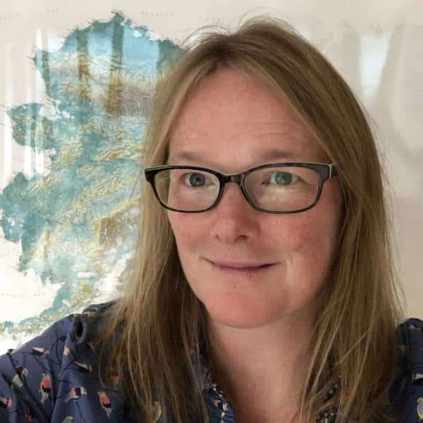




Council Membership
Karla Bush
ADF&G alternate
Rachel Baker
ADF&G
David Witherell
Executive Director
Rudy Tsukada
Bill Tweit
WA DF&W Acting Chairman
Chris Oliver
PSMFC
Steve Williams
OR DF&W
Andy Mezirow
Angel Drobnica
11 voting members
AK (6), WA (3), OR (1), NMFS (1)
7 appointed
4 agency representatives
4 non-voting members
US Fish & Wildlife
US Coast Guard
PSMFC
US State Dept.
Nicole Kimball
Kenny Down
RADM Nathan Moore
US Coast Guard
John Jensen
Jon Kurland
NMFS Regional Dir
Gretchen Harrington
NMFS alternate
Anne Vanderhoeven
page 3
Demian Schane
NOAA GC
USFWS
Pete Fasbender
US Dept of State
David Moore
Notes:
The North Pacific Fishery Management Council has 15 members, 11 of which have voting rights.
The four non-voting seats are held by different agency representatives and the US Coast Guard.

Slide 4

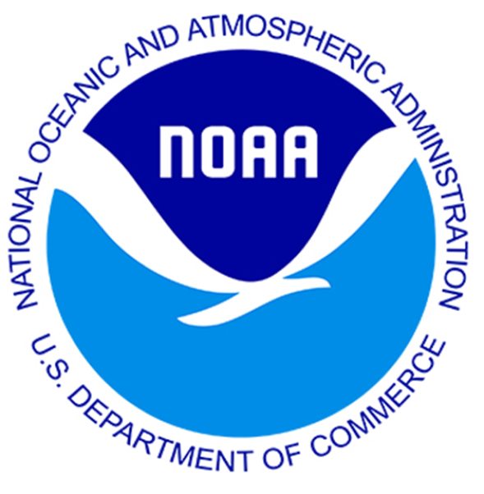
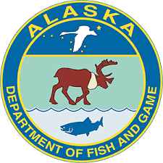
What is the Council’s purpose?
Council makes recommendations to NMFS
The Council, working with experts, stakeholders, staff and the public,
is required to balance conservation, economic, and social concerns with the intent of managing sustainable fisheries for the greatest benefit to the Nation
NMFS approves, implements, and enforces Council recommendations
Management is coordinated, and in some cases jointly managed, with the State of Alaska
Notes:
The Council is charged with making management recommendations to the National Marine Fisheries Service (or NMFS)
This is the agency responsible for promulgating regulations for Federal fisheries management.
So, most often, NMFS approves the recommendations from the Council, implements and enforces the Council’s recommendations as regulations.
These management recommendations are made through a public process, where the Council works with experts, stakeholders, staff, and the public.

Slide 5
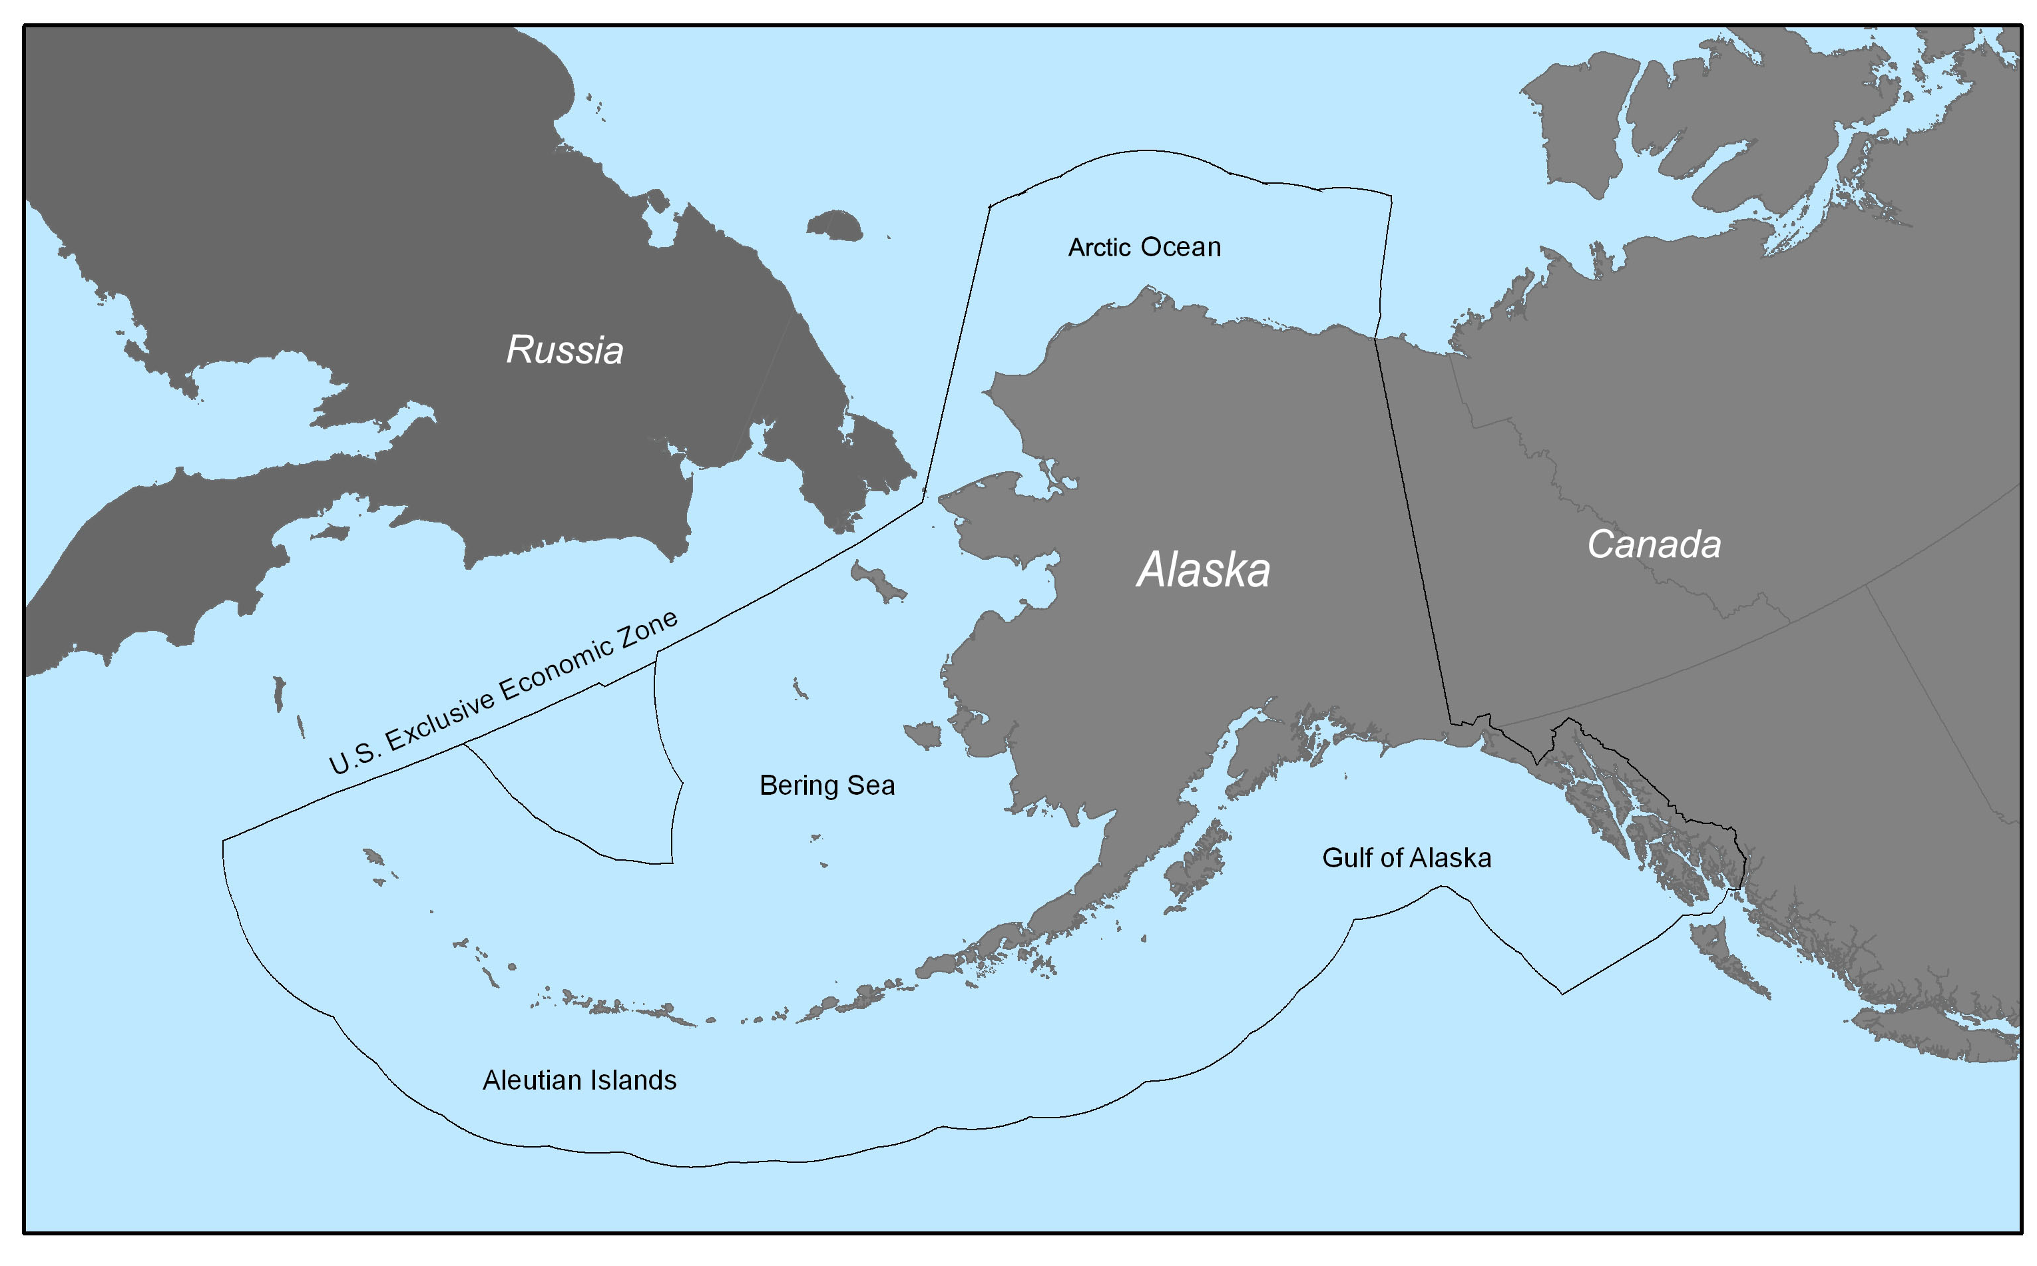
The Council has jurisdiction over four regions in the North Pacific
Bering Sea
Aleutian Islands
Gulf of Alaska
Arctic Ocean
Management Areas
Groundfish
Crab (Joint w. State of Alaska)
Scallop (Joint w. State of Alaska)
Pacific Halibut (Joint w. Canada)
Fisheries
5
Notes:
The Council has authority to make management recommendations for fisheries in several regions including the Bering Sea and Aleutian Islands, the Gulf of Alaska, and the Arctic Ocean.
I would note there is a moratorium on fishing in the Arctic so no commercial fisheries are prosecuted in US Federal waters.

Slide 6





Council Meetings
5 meetings each year
3 are in Anchorage
1 is in a rural fishing community in Alaska
1 is in Washington or Oregon
All meetings are open to the public
Meeting schedules and agendas are available online
Advisory Panel and the Scientific and Statistical Committee meet prior to the Council and provide their input and recommendations
Provide public comment
Advisory Panel, Scientific and Statistical Committee, and Council
In-person or remote options
Listen live!
Participate in person, over Zoom, or catch up later with YouTube recordings
6
Notes:
The Council has five meetings each year – in October, December, February, April, and June.
All Council meetings are open to the public and the meeting schedules and agendas are available on line/open to the public.
There are opportunities to provide public comment at each Council meeting. You can provide comments in writing in advance of a council meeting or orally in-person at the meeting.
All Council meetings are now broadcast online, and the Council allows for remote testimony to be provided.

Slide 7
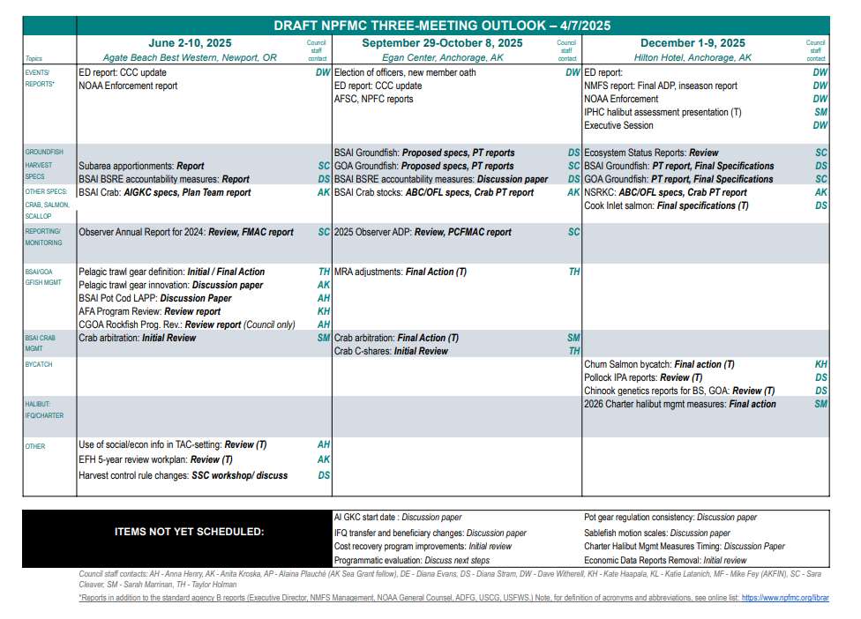

Slide 8
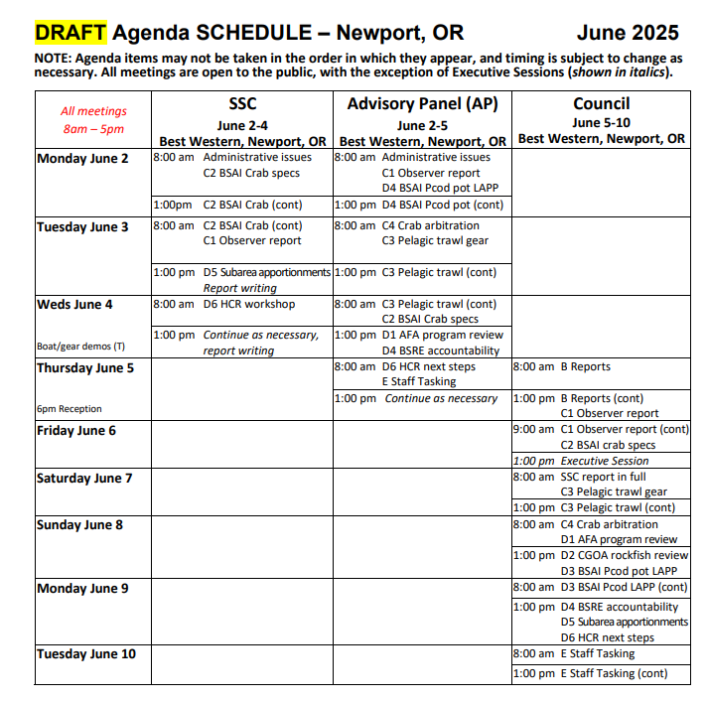
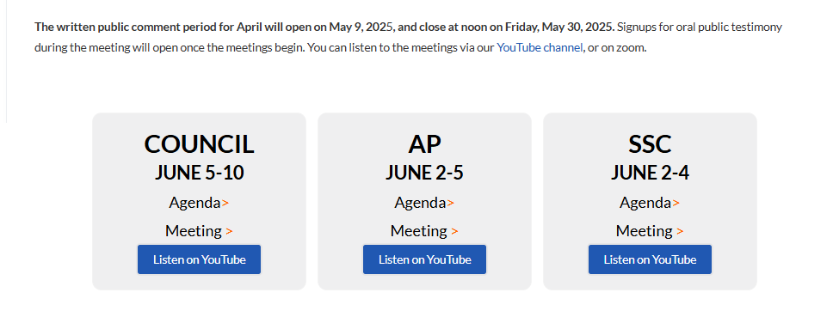
On our website:
https://www.npfmc.org/current-or-next-council-meeting/
Links to both Zoom as well as YouTube

Slide 9
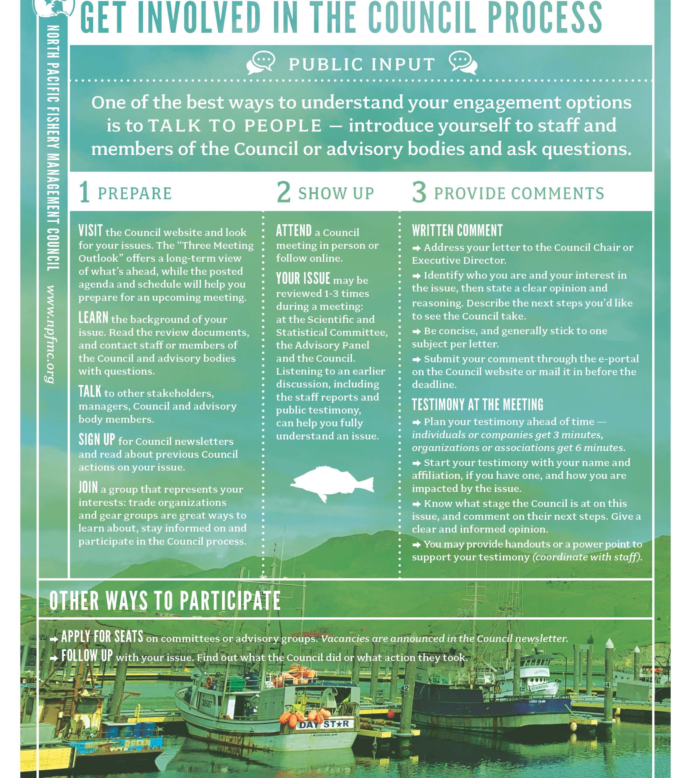

Ways to comment
Letter
Written comment to eAgenda
Public comment in a meeting

Slide 10
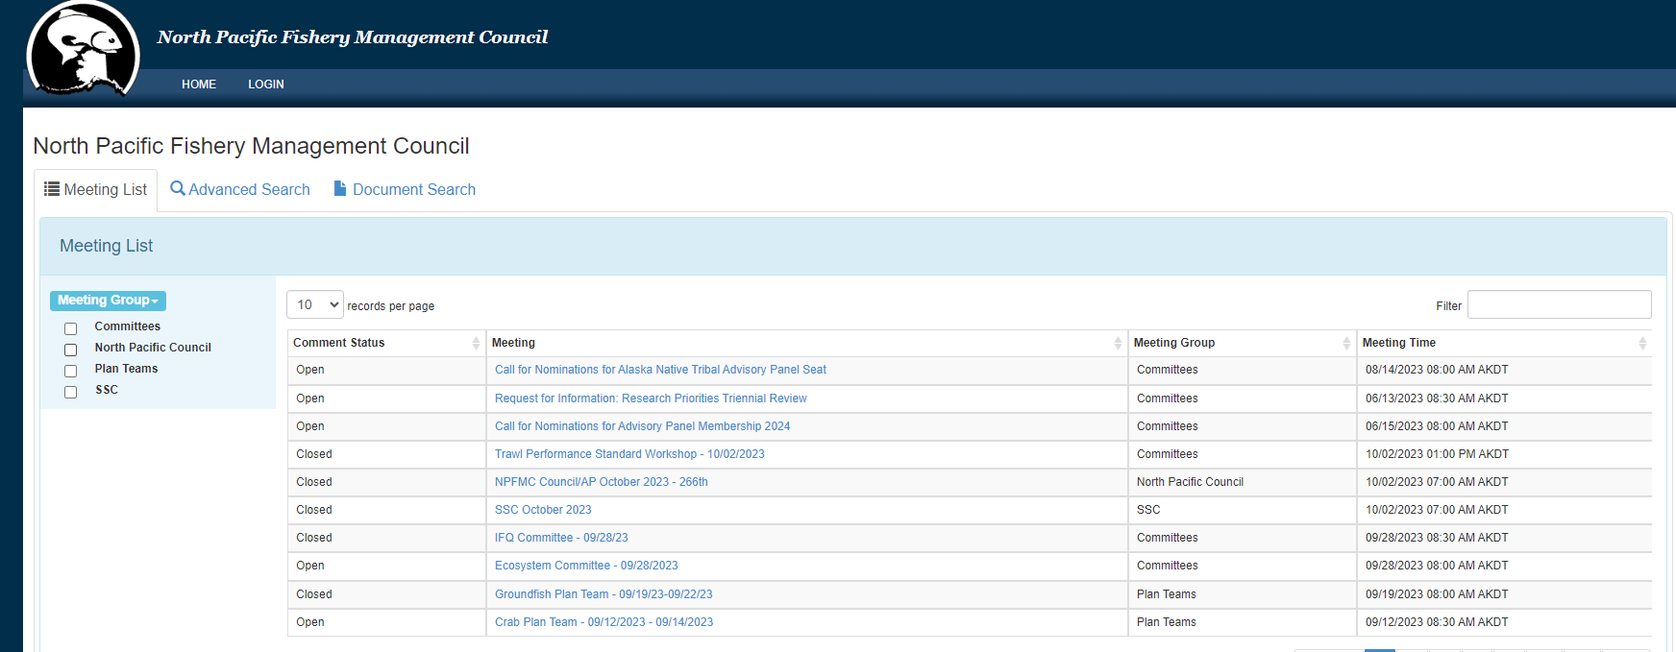
Navigating the meetings page
meetings.npfmc.org
Click a meeting to see the schedule, all documents, post your comment, or sign up to give comment in the meeting

Slide 11
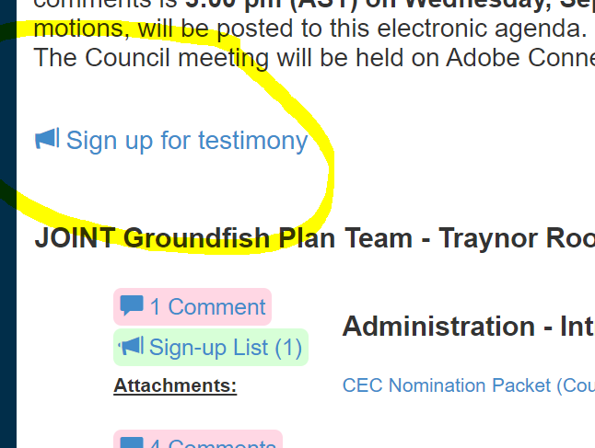
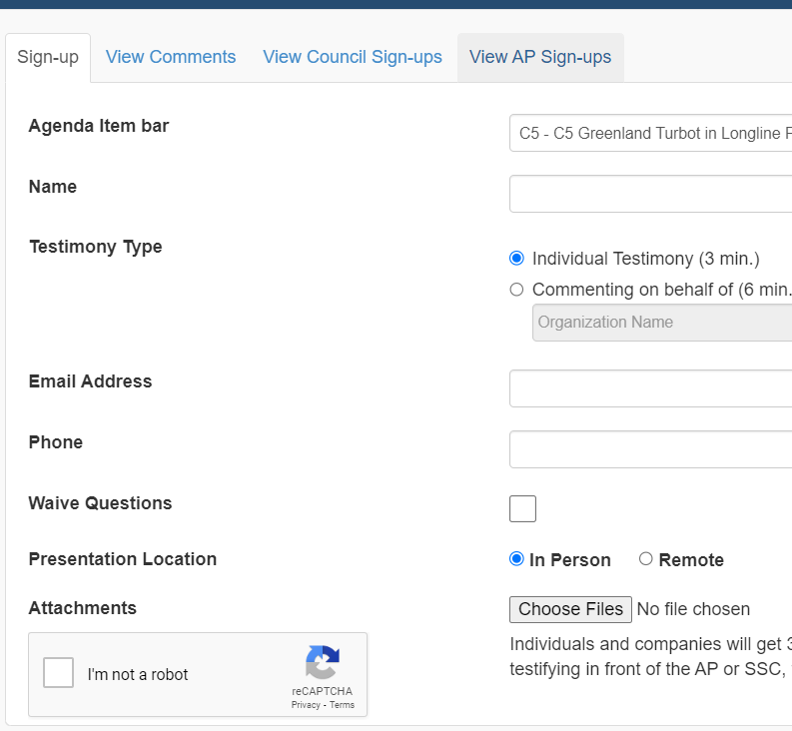
In-meeting public comment
Sign up from the e-Agenda

Slide 12
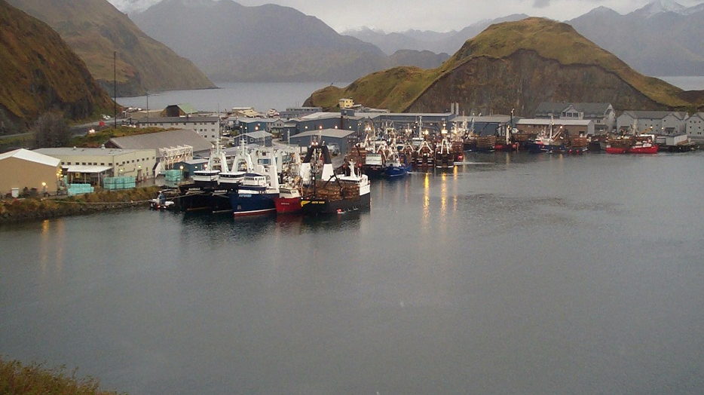
Thank You!!

