Slide 1
Alaska Salmon Research Task Force
Presentation to the
Alaska Bycatch Advisory Council
November 5, 2024
Presented by:
Ed Farley
NOAA Fisheries
Alaska Fisheries Science Center
Juneau, AK
Reference: S.3429 An Act

Slide 2
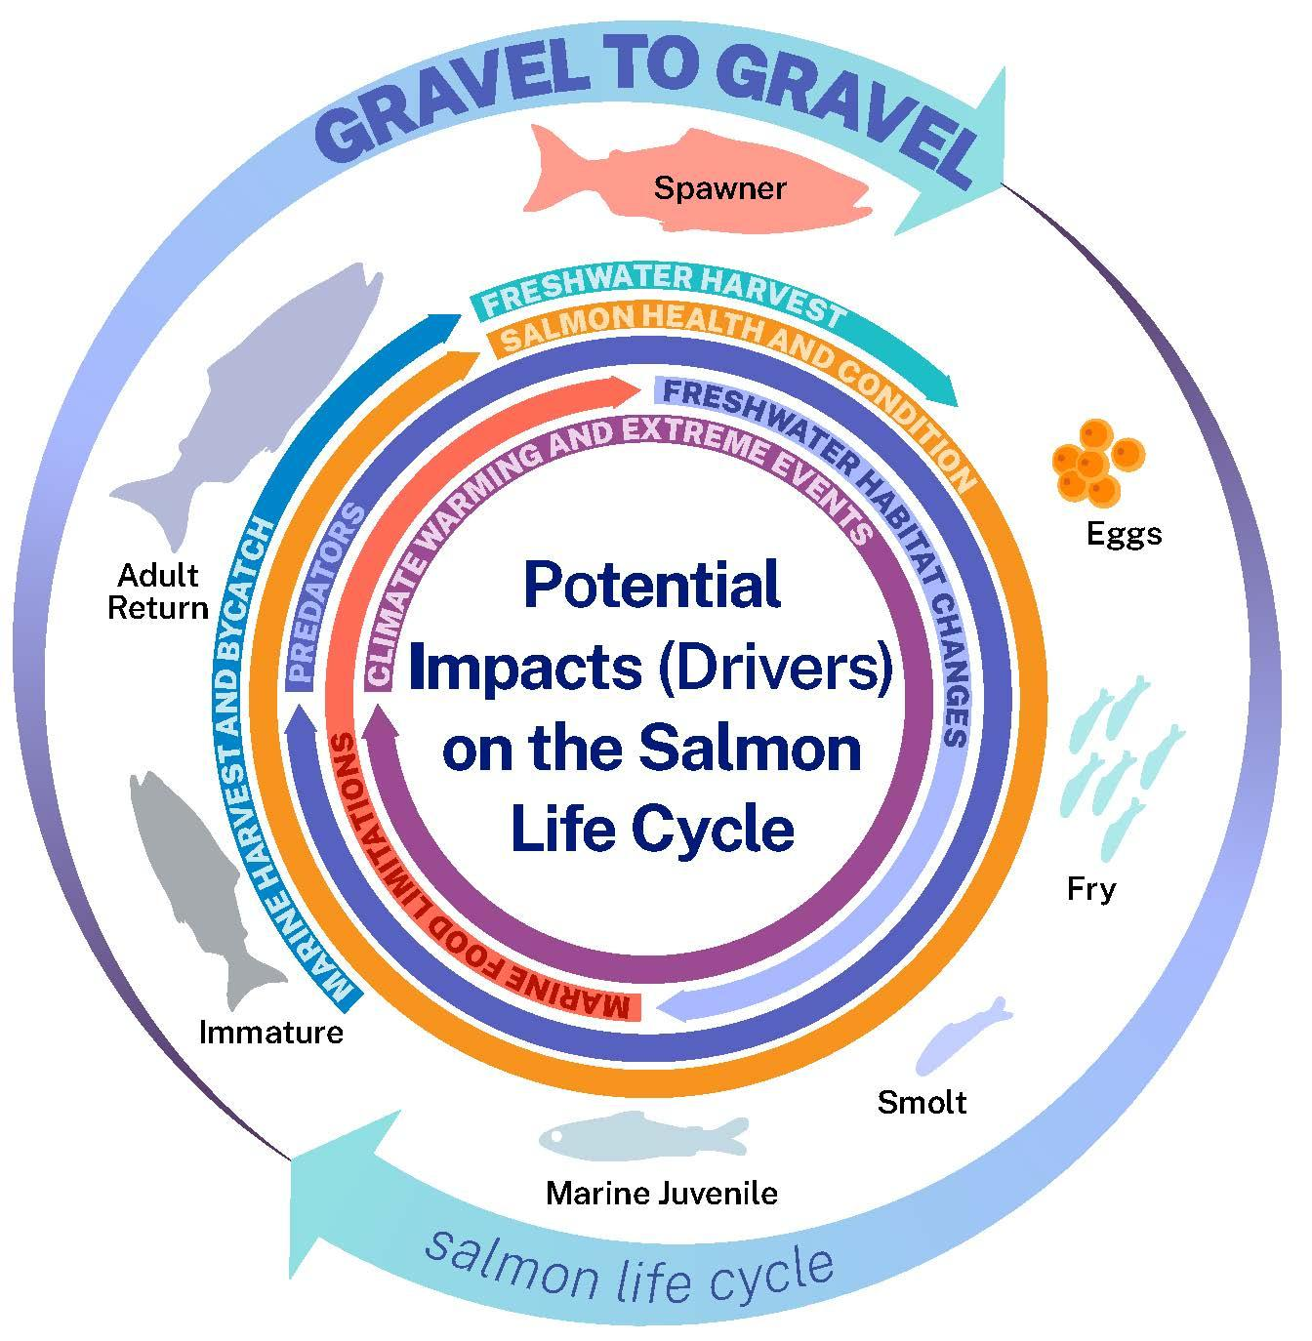
Coordinated Research Strategy
Focus on Marine Harvest and Bycatch

Slide 3
Recommended Applied Strategies to Address Priority Research Needs
Improved understanding of the social impacts
Improved stock identification methods
Better characterization of ocean distributions and marine migration routes
Expanded ocean ecosystem surveys
Strategies to minimize human impacts on freshwater and coastal habitats
Making use of new technologies
More effective monitoring of salmon indicator stocks
Improved stock assessments for in-season management
Life-cycle modeling and management strategy evaluations for climate resilience
Better data management and sharing

Slide 4
AKSRTF Research Priorities and Strategies Link to NPFMC Research Priorities
Further research to reduce western Alaska salmon bycatch in Bering Sea groundfish fisheries (e.g. research on salmon and drivers of salmon distribution, as well as drivers of groundfish fishery behavior including avoidance of other PSC species).
Continue to acquire basic life history information with an emphasis on improved estimates of size/age at maturity to advance understanding of the mechanisms for how maturity changes over space and through time.
Examine the economic, social, and cultural effects of fisheries and fishery management policy on communities over time (including impacts from fishery policy changes and Tribal citizen and Tribal Nation reliance on, participation in, and impacts of federally managed fisheries).
Develop predictive tools and models that evaluate the impact of multiple projected climate scenarios on managed resources to inform management options related to ecosystem production and resilience and adaptation of fishing communities.
Maintain the core biological and oceanographic data (e.g., biophysical moorings, stomach data, zooplankton, age 0 surveys, benthic production) necessary to support integrated ecosystem assessment

Slide 5
AKSRTF Research Priorities - Links with the Alaska Bycatch Task Force
Research to understand Migratory corridors for Pacific salmon
Research to improve age and stock-identification of Chum and Chinook salmon
Research to understand the impact of bycatch on Alaska salmon stocks
Notes:
a) Improved information on marine migration patterns and its relation to fishery locations
b) Improved information on the characteristics of fishery catches.
c) Improved information to help understand fishery impacts
Research to reduce bycatch, interception, and Illegal, Unreported, and Unregulated (IUU) fishing through improved understanding of distribution and migration patterns of Alaska salmon stocks to better predict and avoid incidental harvest in the migratory corridors for Alaska salmon including Bering Sea, Aleutian Island, and Gulf of Alaska areas and regions in the North Pacific where there is increased potential for IUU fishing.
Research to improve our ability to determine the stock origin (wild and hatchery) of chum and Chinook salmon taken in marine harvest, bycatch, and interception.
Research to understand the frequency of occurrence and mortality rate (direct and discard) attributed to unobserved fishing mortality (e.g., IUU, unreported catch, incidental catch/mixed stocks); and once this information is known, determine the impact to the populations.
Research to better define how all sources of marine harvest , including mixed stock fisheries, influence salmon abundance and how this varies by species, stock, and region.
Research to understand genetic diversity and fitness effects from fishing or hatchery influence that may reduce a population’s resilience and ability to recover from climate induced depression of population abundance or low productivity.

Slide 6
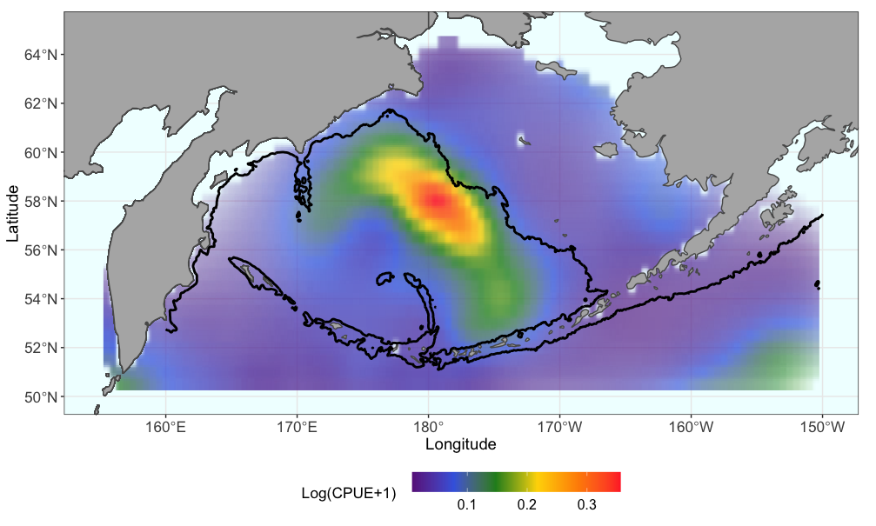
Better characterization of ocean distributions and marine migration routes
Chinook Salmon summer “hotspot” distribution prediction
Langan et al. 2024

Slide 7
Life-cycle modeling and management strategy evaluations for climate resilience
Escapement data
Directed harvest data
  Marine survival
  Maturation schedules
  Spawner-recruitment patterns
  Environmental and anthropogenic impacts
  Distribution and migration models
  Adult Equivalent Models
  Forecasts of Adult returns
  Management Strategy Evaluations
Population dynamics
juvenile survey data/
International Research
BSAI bycatch data
DeFilippo et al. in progress

Slide 8


Juvenile population
Immature population
a=2
a=3
a=4
a=5
a=6
a=7
Natural mortality
Natural mortality
Maturation
Natural mortality
Natural mortality
Mature population
Maturation
Natural mortality
Maturation
Natural mortality
Maturation
Bycaught population
Bycatch mortality
Bycatch mortality
Bycatch mortality
Bycatch mortality
Natural mortality
Natural mortality
Natural mortality
Natural mortality
Directed Harvest
Ricker
S-R
U.S. Department of Commerce | National Oceanic and Atmospheric Administration | NOAA Fisheries | Page 8
AEQ
DeFilippo et al. in progress
Maturation
Maturation
Maturation
Maturation

Slide 9
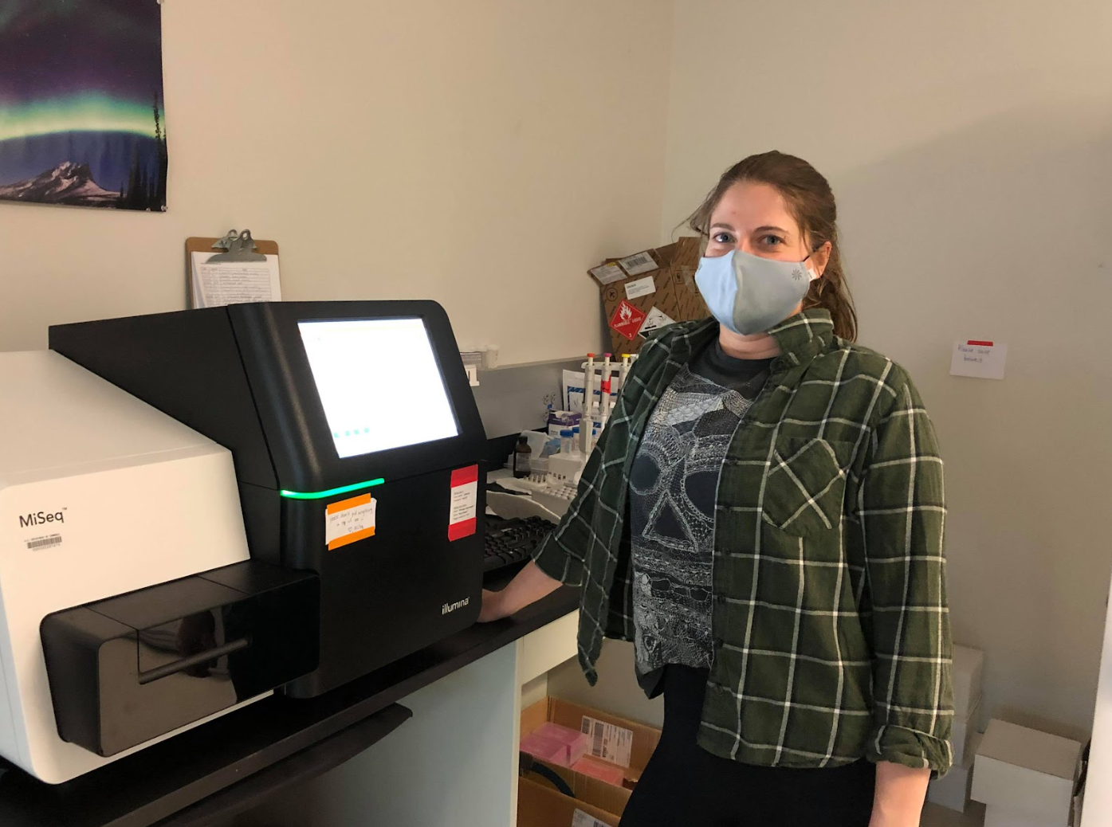
Improved stock identification methods
AYKSSI project to improve stock resolution of Chum salmon with genomics
Contact: wes.larson@noaa.gov with questions

Slide 10
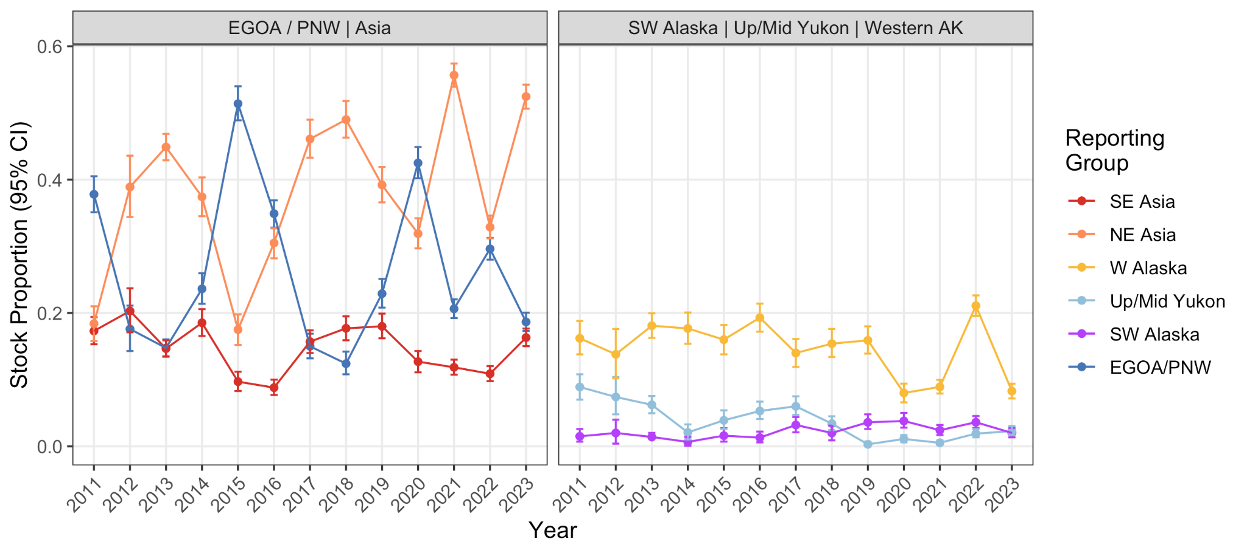
More effective monitoring of salmon indicator stocks
Stock proportions of BSAI chum salmon through time
Recently reduced turnaround time by nearly a year for both species
Working with Bristol Bay Science and Research Insitute to produce in-season reports for chum
Contact: wes.larson@noaa.gov with questions

Slide 11
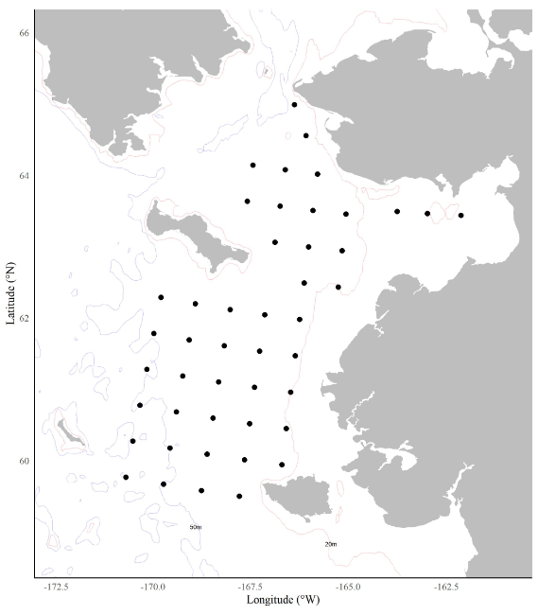
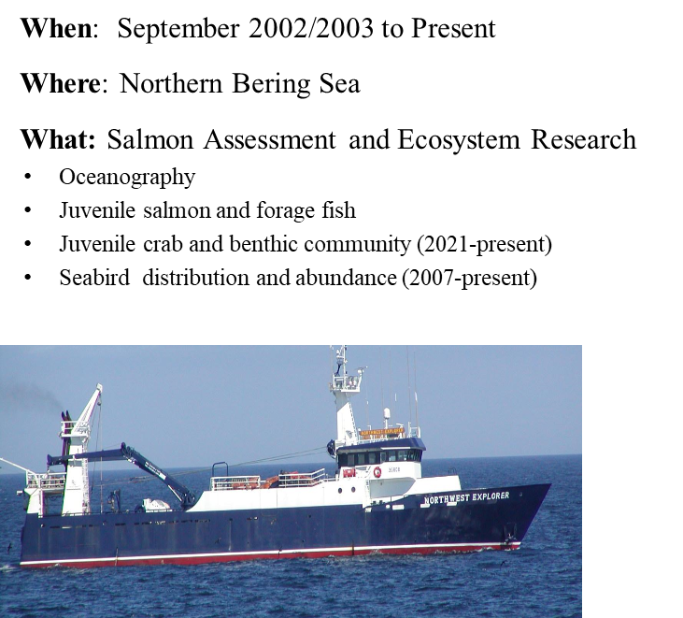
Expanded ocean ecosystem surveys
Contact: jim.murphy@noaa.gov and kathrine.howard@alaska.gov

Slide 12
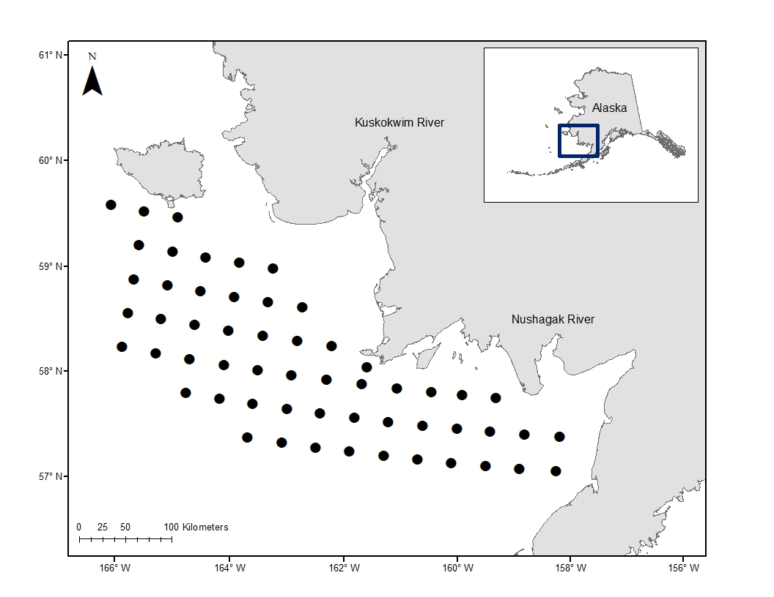
Expanded ocean ecosystem surveys
NEW: Southern Bering Sea juvenile salmon survey overview (Garcia, Gray, Howard)
ADFG
Survey plan
  56 stations
  Nordic 264 or CanTrawl
  September 1 - 30
Planned sampling protocols
  Fish
  Zooplankton
  eDNA
Contact: kathrine.howard@alaska.gov

Slide 13
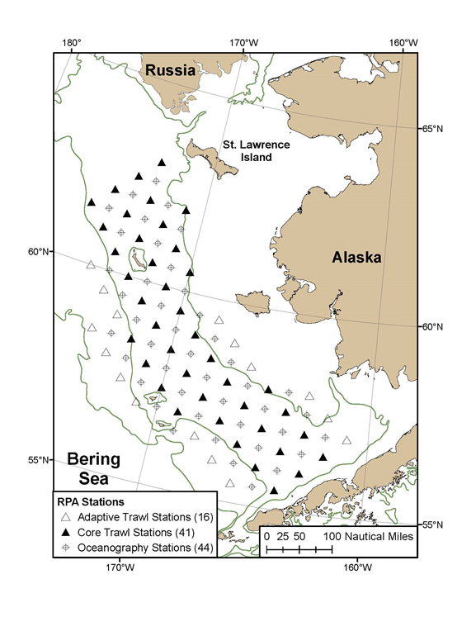
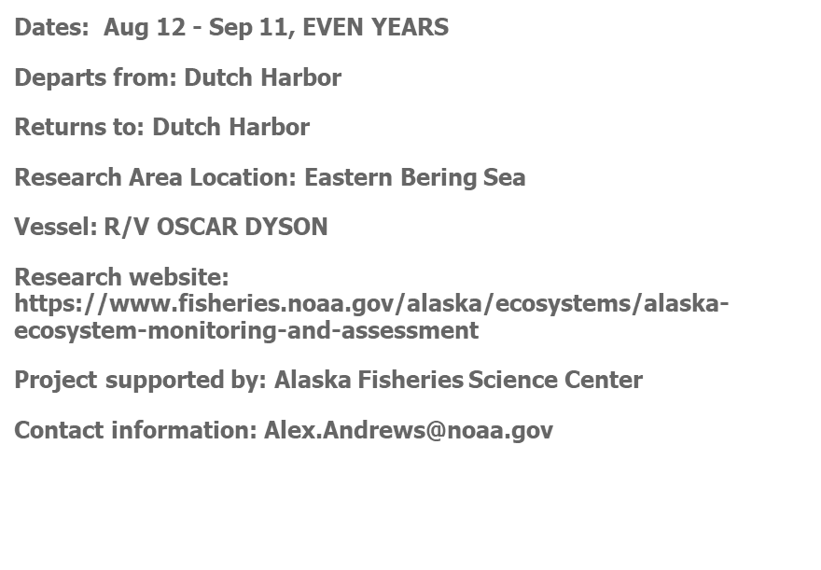
Expanded ocean ecosystem surveys
Contact: alex.andrews@noaa.gov

Slide 14
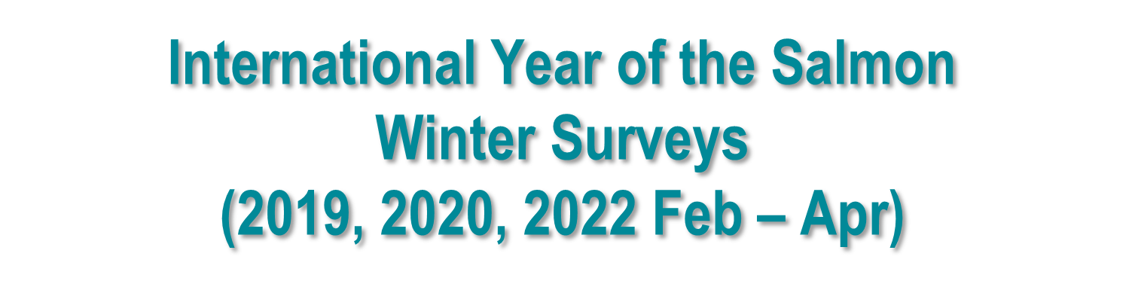
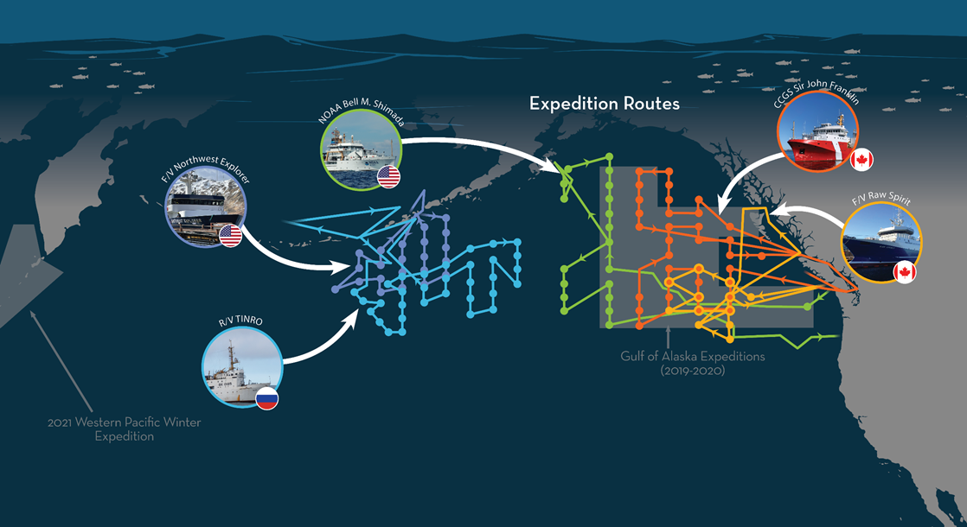
Expanded ocean ecosystem surveys
Contact: jim.murphy@noaa.gov and kathrine.howard@alaska.gov

Slide 15
Future Requests
Please contact
Wes Larson at wes.larson@noaa.gov
and
Lukas DeFilippo at lukas.defilippo@noaa.gov

Slide 16
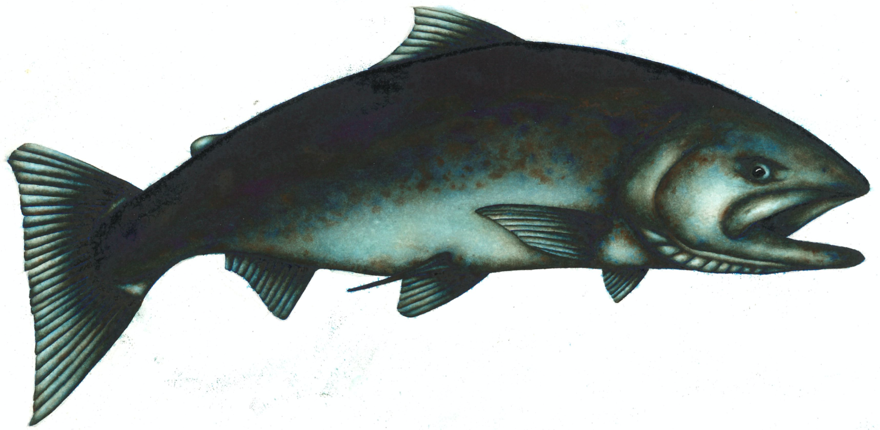
Questions?

